Slide 1

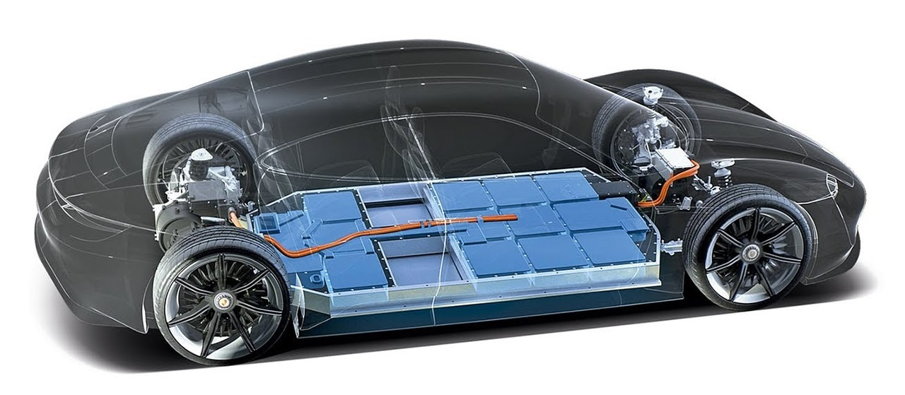

EV parameter
Uncertainty Scenarios
Battery Fault (Normal / Abnormal)
Unpredictable EV Behavior (Random Arrival & Departure time)
Charging Efficiency error
EV
EV Configuration
Charge Plug Type (5pin & 7pin)
Plug time
Target SoC
Plug-in SoC
EVCS
Battery Fault Diagnosis
Unpredictable EV Behavior
1PM
2PM
3PM
4PM
5PM
In schedule
Diagnose Battery
1PM
2PM
3PM
4PM
5PM
Normal or Abnormal
At real

Slide 2
EVCS parameter
EV Spec
Plug-in SoC
Target SoC
EV Configuration
Plug-time
Charge Plug Type
Other Model
EV Model Output
Aggregator Output (Charging Strategy Event Response Manual)
Uncertainty
Mode Changed
Communication Time Delay
Hardware error
input
To Aggregator
Plug in/out event
Battery status
To EV
Charging Strategy
output
input
Day | ID | cap | init | target | in | out | Pmin | Pmax | Error rate | Connection Err | Communication Err | Hardware Error
0 | EV0 | 72.6 | 0.8 | 0.75 | 14 | 36 | -5 | 11 | 0 | 1 | 0 | 0
0 | EV1 | 72.6 | 0.8 | 0.75 | 9 | 16 | -5 | 11 | 7 | 0 | 0 | 0
0 | EV2 | 72.6 | 0.4 | 0.75 | 18 | 20 | -5 | 11 | 20 | 0 | 0 | 1
0 | EV3 | 72.6 | 0.6 | 0.75 | 21 | 43 | -5 | 11 | 10 | 0 | 1 | 0
0 | EV4 | 72.6 | 0.4 | 0.75 | 10 | 30 | -5 | 11 | 5 | 0 | 0 | 0
0 | EV5 | 72.6 | 0.4 | 0.75 | 15 | 39 | -5 | 11 | 3 | 0 | 0 | 0
0 | EV6 | 72.6 | 0.3 | 0.75 | 19 | 33 | -5 | 11 | 0 | 1 | 0 | 0

Slide 3
Simulator
Bidding Price
Input
Market type (DR, FR…)
Output
Aggregator
Market
Bidding result
Market Price Uncertainty
DR, FR Signal
Bidding Price Uncertainty
Plug-in/out event
Bidding Capacity Uncertainty
All Configuration from EVs
Charging Strategy
Uncertainty Parameter
Event Response Manual
EVCS
(Station)
EVCS
(Station)
EVCS
(Station)
EVCS
(Station)
Hardware Error
Charge Plug Type
Communication time delay
Plug-time
Charging Strategy
EV Configuration
Uncertainty
Target SoC
Plug-in SoC
Battery Fault
Random Arrival & Departure
…
Charging Efficiency error
EV
EV
EV
EV
EV

